Slide 1
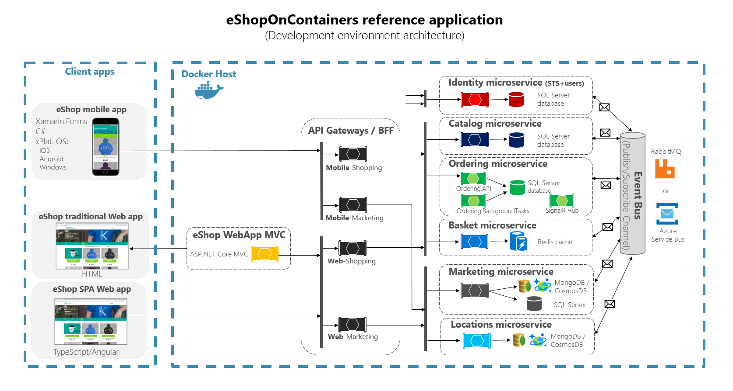


.NET Core 2.1
https://github.com/dotnet-architecture/eShopOnContainers
AKS

